Slide 1


A PROJECT BY
NEXTHIKE IT SOLUTIONS
“Sales Forecasting Across Multiple Retail Stores Using Machine Learning”
By Mr. Ajay Kumar Sahu

Slide 2
Points for Discussion
Introduction
Problem statement
Data Description
Data Preprocessing
Exploratory Data Analysis (EDA)
Feature Engineering
Model Building
Model Evaluation
Feature Importance Analysis
Deployment
Conclusion
Final Statement

Slide 3
Introduction:
This project focuses on predicting daily sales for Rossmann retail stores using machine learning techniques. Accurate sales forecasting helps businesses in inventory management, staff allocation, and strategic decision-making.
Sales forecasting is an essential task in retail business operations. It helps in: - Inventory management - Staff planning - Financial decision making Machine learning enables accurate prediction based on historical data.

Slide 4
Problem Statement
The objective of this project is to build a predictive model that estimates daily sales based on historical data such as promotions, holidays, and store-related features.
“The goal is to estimate future sales using past data patterns.”

Slide 5
Data Summary
The dataset consists of two main files:
train.csv: Contains historical sales data
store.csv: Contains store-related information
Key features include:
Store ID
Sales (Target Variable)
Promo
StateHoliday
SchoolHoliday
Date
“We combined store information with sales data for better prediction.”

Slide 6
Data PREPROCESSING
The following preprocessing steps were performed:
Merged train and store datasets using Store ID
Converted Date column into datetime format
Extracted Day, Month, and Year features
Handled missing values using appropriate techniques
Removed closed store records
“Data preprocessing ensures data is clean and suitable for model training.”

Slide 7
EXPLORATORY DATA ANALYSIS (EDA)
EDA was conducted to understand patterns and relationships in the data:
Sales distribution analysis
Impact of promotions on sales
Monthly sales trends
Key Insight: Sales increase significantly during promotional periods, highlighting the importance of marketing strategies.
“EDA helps identify relationships between variables and sales.”

Slide 8
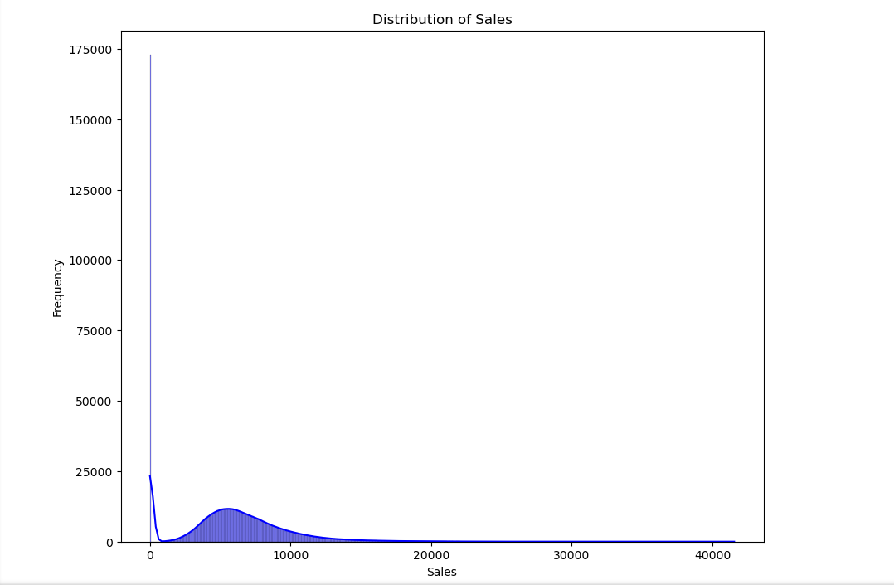
Sales distribution
A. Observation:
Sales show wide variation across stores.
Most values are concentrated in a specific range.
“This shows that sales are not uniform and vary significantly.”

Slide 9
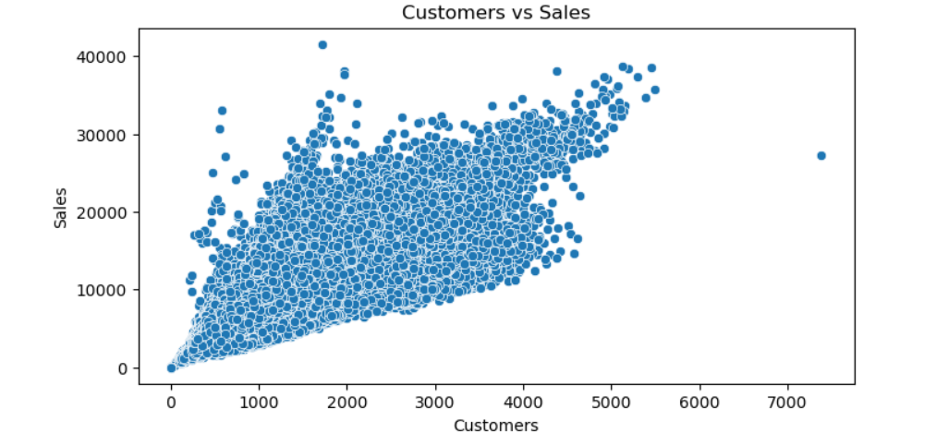
customer vs sale
B. Observation:
There is a strong positive relationship between customers and sales. As the number of customers increases, the sales value also increases significantly. This indicates that customer count is a key driver of sales.
“More customers means more purchases, which directly increases total sales.”

Slide 10
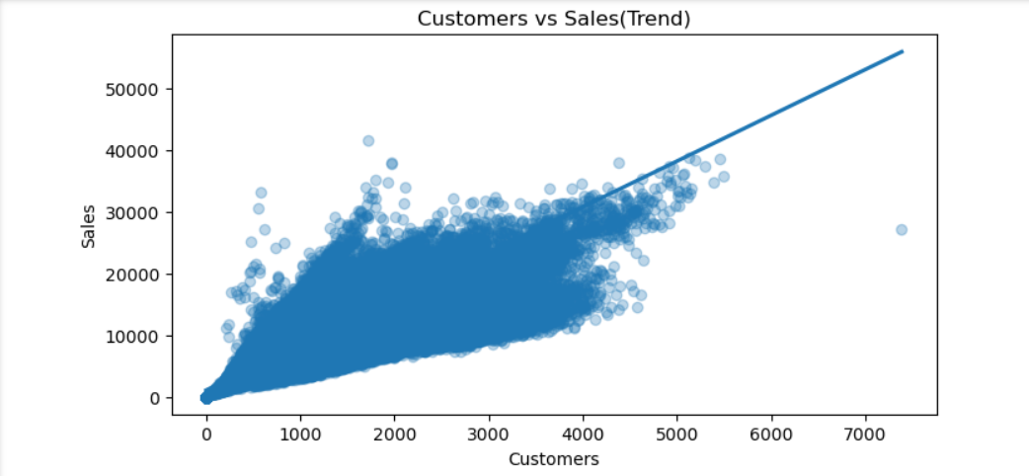
Monthly sales trend
C. Observation:
The trend shows a strong positive relationship between customers and sales.
As the number of customers increases, sales also increase steadily.
This indicates a direct and consistent upward trend.
“This graph shows that more customers lead to higher sales, which means customer count is a key factor in predicting sales.”

Slide 11
Feature engineering
Extracted Day, Month, Year from Date
Converted categorical features into numeric using encoding
Prepared dataset for machine learning model
“Feature engineering improves model understanding and accuracy.”

Slide 12
Model building
A Random Forest Regressor was used for prediction due to:
Ability to handle non-linear relationships
Robust performance on large datasets
Reduced risk of overfitting
Provides high accuracy
“Random Forest is suitable for regression problems with complex patterns.”

Slide 13
Model training
Split data into training and testing sets
Trained model using training dataset
Tested on unseen data
“This ensures the model generalizes well to new data .”

Slide 14
Model evaluation
The model performance was evaluated using:
Mean Absolute Error (MAE): 273.91147225557677
Root Mean Squared Error (RMSE): 210136.37541130715
R² Score: 0.98578443171933
The model demonstrated good predictive capability with acceptable error rates.
“Model shows good predictive performance .”

Slide 15
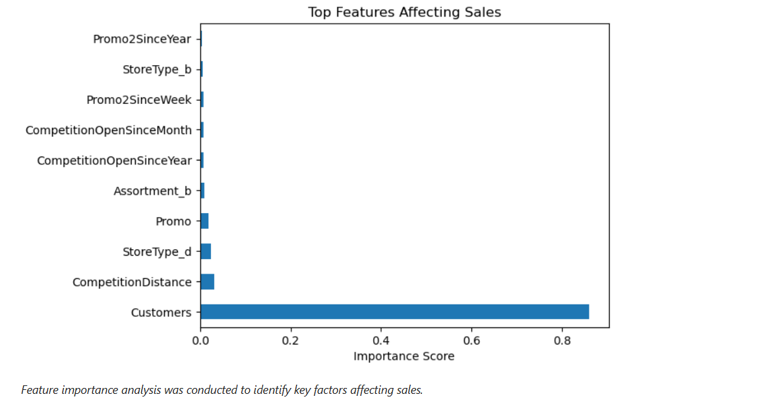
Feature importance
Feature importance analysis revealed that:
The graph shows the importance of different features affecting sales.
The 'Customers' feature has the highest importance, indicating it is the most influential factor in predicting sales.
Other features like Promo and Competition Distance have relatively lower impact.
“It shows which features are most important for predicting sales, and customers is the most important one.”

Slide 16
Model deployment
The model was deployed using Streamlit, providing:
User-friendly interface created
Real-time sales prediction
Interactive input options
Store, Promo, Holiday, and Date
“This model is accessible through a web application .”

Slide 17
Conclusion
Successfully developed a machine learning model for sales prediction
Identified key factors influencing sales
Demonstrated practical application through deployment
Model helps in business decision-making
“This model can be used for real-world retail analytics .”

Slide 18
Future scope
Implement advanced models such as LSTM
Improve feature engineering techniques
Deploy application on cloud platforms for wider accessibility
“Future improvements can enhance accuracy and scalability .”

Slide 19
THANK YOU!
Grateful for your time and attention. Your feedback and insights are deeply appreciated!
Mr. Ajay Kumar Sahu
ajaykumarsahu2017.1997@gmail.com

